Slide 1
X3D Ontology for Semantic Web X3D Semantic Web Working Group
Don Brutzman and Jakub Flotyński
brutzman@nps.edu flotynski@kti.ue.poznan.pl
29 July 2020

Slide 2
Semantic Web
W3C is helping to build a technology stack to support a “Web of data” supported by Semantic Web standards.
Wikipedia: “The Semantic Web is an extension of the World Wide Web through standards set by the World Wide Web Consortium (W3C). The goal of the Semantic Web is to make Internet data machine-readable. To enable the encoding of semantics with the data, technologies such as Resource Description Framework (RDF) and Web Ontology Language (OWL) are used. These technologies are used to formally represent metadata. For example, ontology can describe concepts, relationships between entities, and categories of things. These embedded semantics offer significant advantages such as reasoning over data and operating with heterogeneous data sources.”

Slide 3
X3D Semantic Web Working Group 1
The X3D Semantic Web Working Group mission is to publish models to the Web using X3D in order to best gain Web interoperability and enable intelligent 3D applications, feature-based 3D model querying, and reasoning over 3D scenes.
Motivations
Establish best practices for metadata and semantic information/relationships using X3D as a Web-based presentation layer.
Enable authors to utilize the power of X3Dv4 and HTML5/DOM together in any Web page utilizing a family of specifications and practices provided by the Semantic Web, such as HTML5 Microdata (microformats) and Linked Open Data, MPEG-7 and related references.
Align the X3Dv4 specification with these standards as best possible to further enable the Digital Publishing industry and communities.
Describe value proposition for utilizing semantic information in concert with archival export, publishing, visualization, and printing of any 3D model as X3D.

Slide 4
X3D Semantic Web Working Group 2
Goals
Enable more effective indexing, search, comparison, and analysis of X3D models through the advanced use of metadata, shape geometry, etc.
Create, autogenerate X3Dv4 OWL ontology from X3D Unified Object Model (X3DUOM) using best-practice design patterns, starting with those shown by prior published work.
Support various Web3D Working Groups including Computer-Aided Design (CAD), 3D printing/scanning, Medical, Cultural and Natural Heritage, Humanoid Animation (HAnim) design work may consider other potential domains such as Building Information Models (BIM), etc.
Build list of domain-specific controlled vocabularies and taxonomies suitable for use with X3D Ontology.
Maximize interoperability with Semantic Web standards for greatest possible reuse, integration with Web.
Outcomes
Create appropriate specifications and recommended practices.
Build suite of exemplars and tools exposed through various portals.
Publish X3D Ontology in multiple formats: Terse RDF Triple Language (Turtle), RDF/OWL, (TODO) JSON-LD.

Slide 5
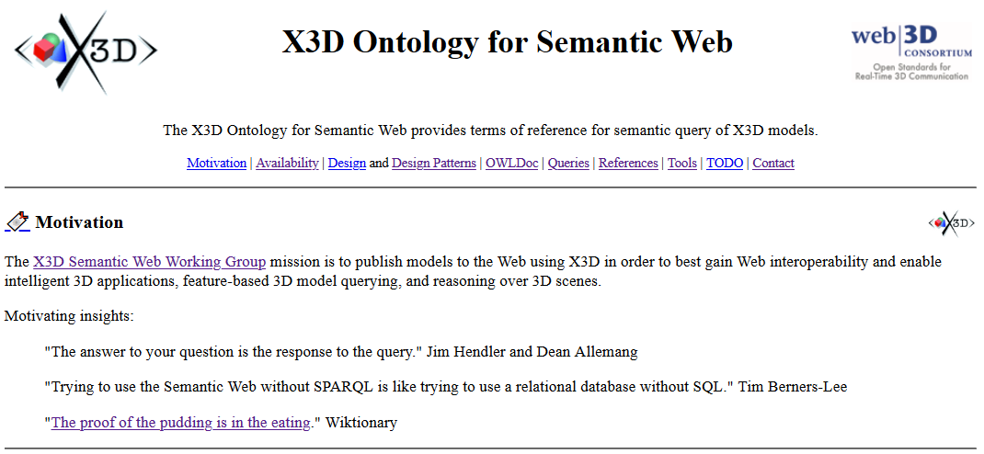
https://www.web3d.org/x3d/content/semantics/semantics.html

Slide 6
What is the X3D Ontology?
A thorough representation of X3D Architecture using RDF and OWL.
RDF: Resource Description Framework
OWL: Web Ontology Language
Expressed in Turtle form, the Terse Triple Language (.ttl)
A strictly typed definition of all X3D nodes, fields and data types.
A way to “explode” an X3D model into subject-predicate-object triples.
Basis for model search and query reasoning when
Example X3D scene is also converted into .ttl form
Queries are written in SPARQL, the SPARQL Protocol and RDF Query Language
Experimental, but design examples are converging satisfactorily.

Slide 7
What is the X3D Ontology not?
X3D Ontology is not suitable for scene graph rendering in real time.
X3D Ontology is not suitable for programmatic model creation.
Also not suitable for most tasks familiar to 3D graphics modelers.
This is because triple form of an X3D model is instead optimized for search queries and logical inference, using Semantic Web technologies.
Current activity includes the possibility of round-trip conversion, but only as a way to confirm complete mappings of all model information. Equivalent information models are possible, but for different purposes.

Slide 8
Assets available for X3D Ontology testing
X3dOntology4.0.ttl is our primary work.
OWLDoc documentation is generated via Protégé ontology editor.
X3dToTurtle.xslt conversion stylesheet for converting an .x3d model from XML into .ttl triples.
X3dSemanticWebDevelopmentArchive.zip collects current assets for easier download and use.
Build process: build.xml uses Apache Ant and Apache Jena ARQ with output logs: build.all.log.txt and build.SPARQL.query.tests.log.txt
This Web3D work is Open Source and maintained in version control.

Slide 9

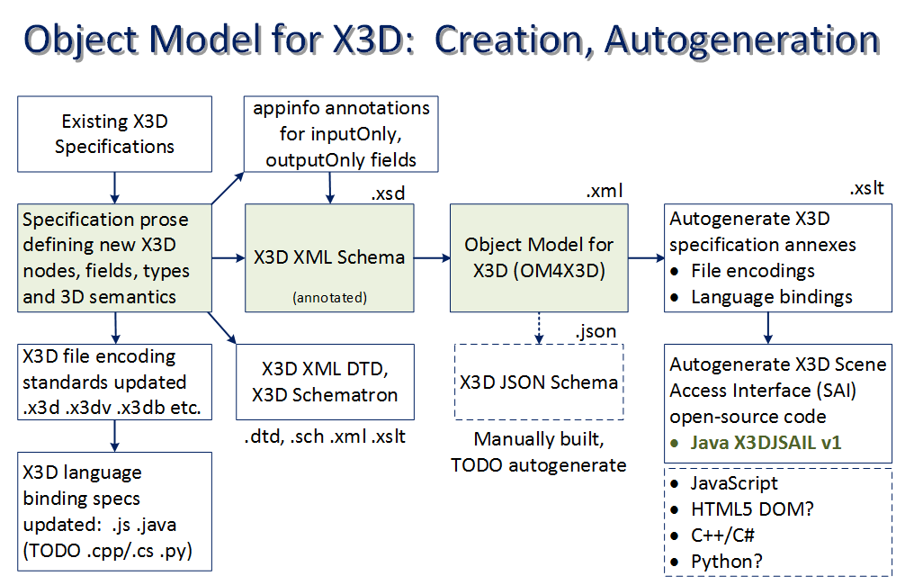
X3D Ontology Production Chain
Creation of the X3D Ontology is thorough and autogenerated for each version of X3D, based on X3D Unified Object Model (X3DUOM)
X3D Standards
X3D Unified Object Model (X3DUOM)
X3D Ontology
and Turtle

Slide 10
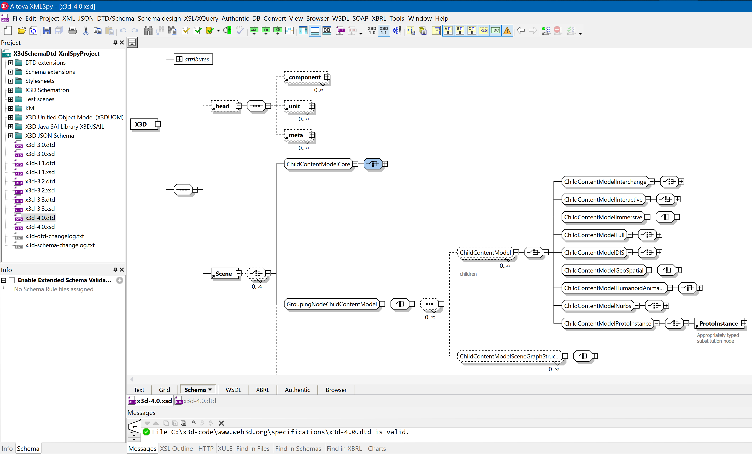
XML Schema decorated with full X3DUOM annotations

Slide 11
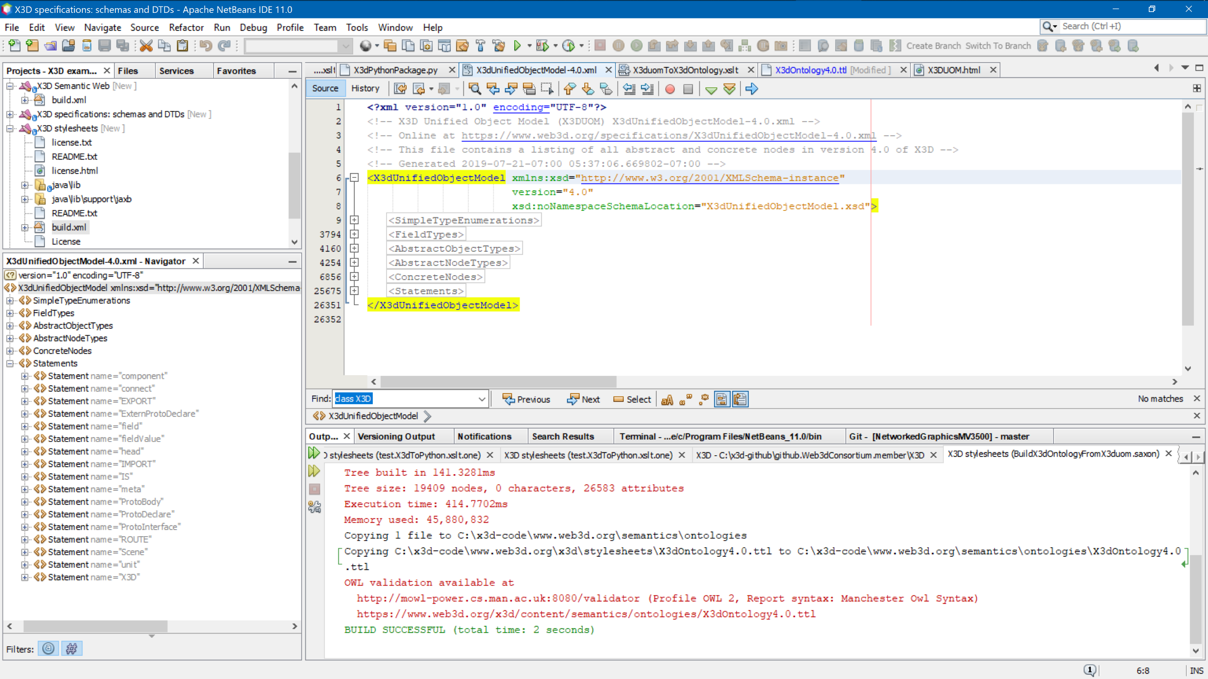
X3DUOM in Netbeans

Slide 12
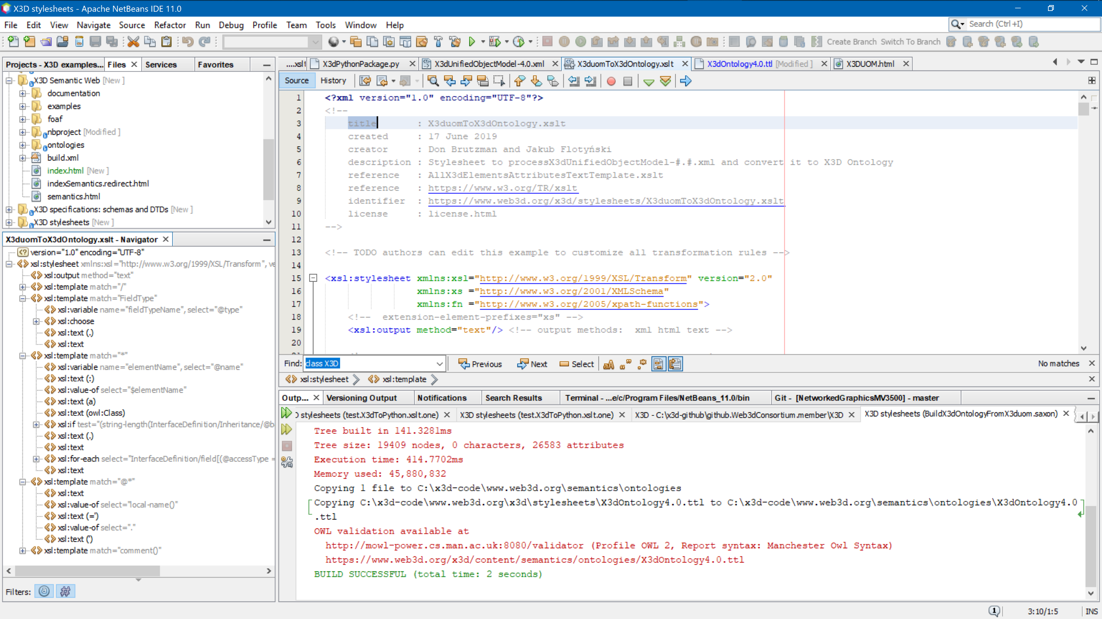
X3duomToX3dOntology.xlst stylesheet

Slide 13
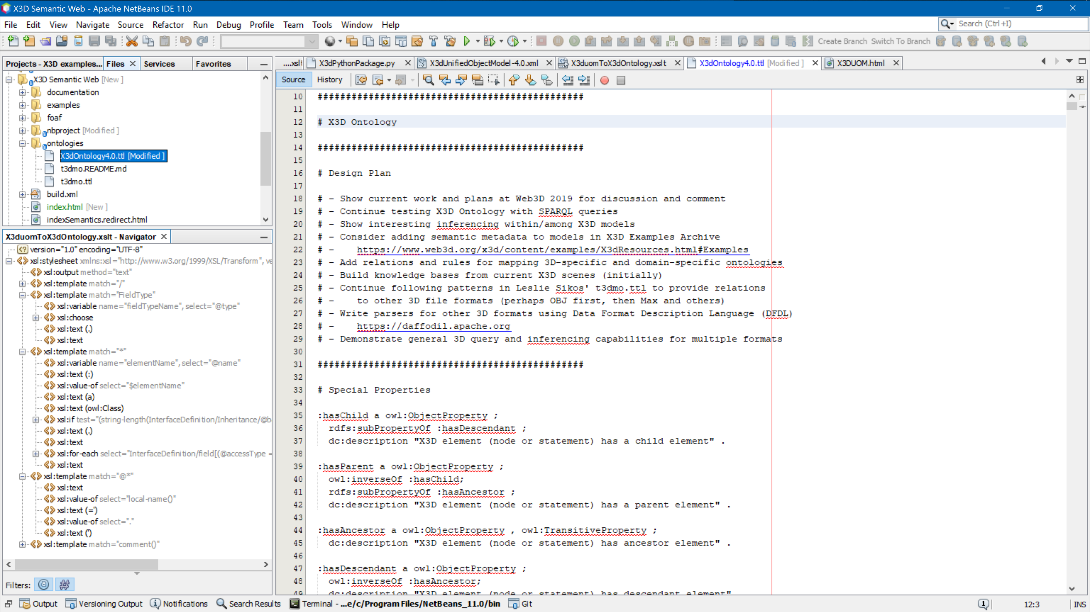
X3d Ontology source (excerpt)

Slide 14
X3D Ontology excerpt
Full set of data typing and scene graph parent-child relationships available.
Enables precise query of any X3D model.
:WorldInfo a owl:Class ;
rdfs:subClassOf :X3DInfoNode ;
rdfs:label "WorldInfo contains a title and simple persistent metadata information about an X3D scene. This node is strictly for documentation purposes and has no effect on the visual appearance or behaviour of the world." .
:info a owl:DatatypeProperty ;
rdfs:domain :WorldInfo ;
rdfs:range :MFString .
:title a owl:DatatypeProperty ;
rdfs:domain :WorldInfo ;
rdfs:range :SFString .
# DEF field inheritedFrom=X3DNode with accessType=inputOutput, type=SFString, baseType=xs:ID
# USE field inheritedFrom=X3DNode with accessType=inputOutput, type=SFString, baseType=xs:IDREF
# class field inheritedFrom=X3DNode with accessType=inputOutput, type=SFString, baseType=xs:NMTOKENS
# IS field inheritedFrom=X3DNode with accessType=inputOutput, type=SFNode, default=NULL
# metadata field inheritedFrom=X3DNode with accessType=inputOutput, type=SFNode, default=NULL

Slide 15
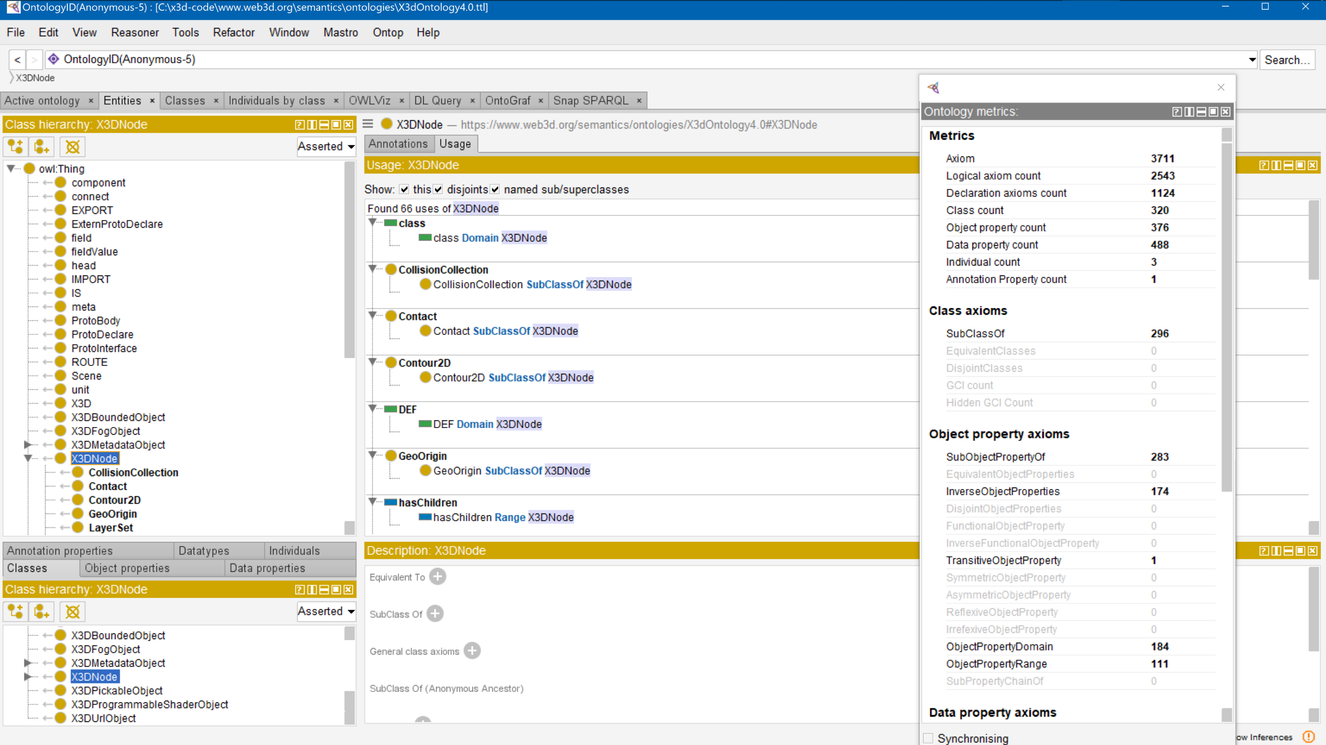
X3D Ontology in Protégé

Slide 16
X3D model representation in Turtle .ttl form
Goal: broadly apply X3D Ontology to enable precise, in-depth SPARQL queries
Unique naming pattern is necessary for each X3D node in a model:
DEF names, if available, are prefixed by a colon. Example: :MySpecialMaterial.
USE names, if available, are adapted by prefixing with a colon and appending -USE- and the number of current occurrence. Example: :MySpecialMaterial-USE-4.
X3D, head and Scene are always singletons and so are eponymous and always get the same name, e.g. :X3D, :head and :Scene.
Unnamed X3D nodes and statements are identified with the following pattern: node name, followed by tree hierarchy below the root X3D node.
Example labels: :meta_1_5 had 1 for head and 5 for fifth child; :Shape_2_3_2_1 has initial 2 for Scene followed by second/second/first children nodes, and so on
Automate conversion .x3d to .ttl using X3dToTurtle.xslt stylesheet
Convert all models and metadata in X3D Examples Archives for testing!

Slide 17
Full set of examples
Several thousand XML-based .x3d models in the X3D Example Archives have been converted into .ttl Turtle triples, using the X3dToTurtle.xslt conversion stylesheet.
Both .ttl and SPARQL query results are available for each model, as illustrated in the screenshot for the HelloWorld example catalog entry.
Comprehensive conversion and test-query results for all models in X3D Resources, Examples: Scene Archives for X3D are listed in build.turtle.all.log.txt. This is a comprehensive set of unit tests for X3D ontology, xslt model conversion into .ttl, and SPARQL query.

Slide 18
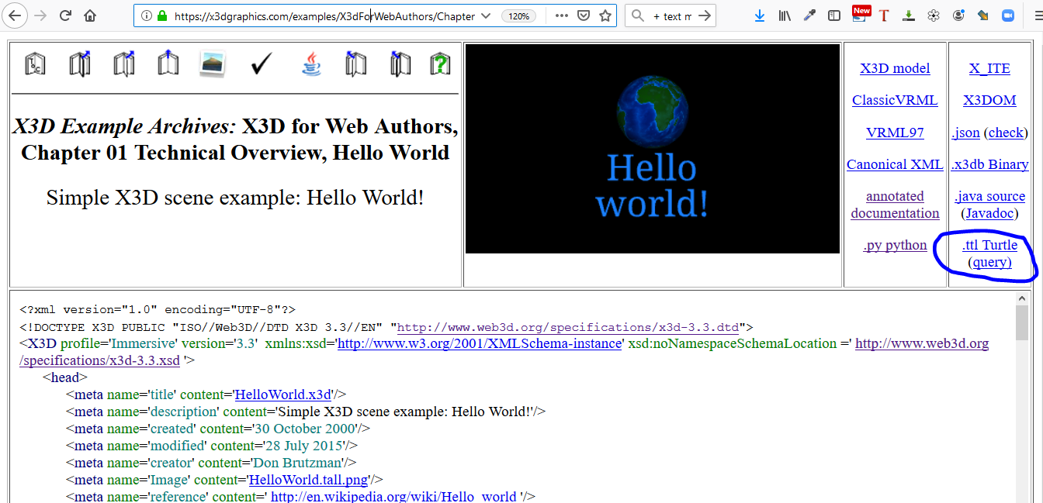
Example model in X3D Examples Archive: Hello World

Slide 19
Example excerpt, HelloWorld.ttl (converted from HelloWorld.x3d)
:Shape_2_3_2_1 a owl:NamedIndividual, x3do:Shape ;
x3do:hasParent :TestWhitespaceCommas ;
x3do:hasGeometry :Sphere_2_3_2_1_1 ;
x3do:hasAppearance :Appearance_2_3_2_1_2 .
:Sphere_2_3_2_1_1 a owl:NamedIndividual, x3do:Sphere ;
x3do:hasParent :Shape_2_3_2_1 .
:Appearance_2_3_2_1_2 a owl:NamedIndividual, x3do:Appearance ;
x3do:hasParent :Shape_2_3_2_1 ;
x3do:hasMaterial :MaterialLightBlue ;
x3do:hasTexture :ImageCloudlessEarth .
:MaterialLightBlue a owl:NamedIndividual, x3do:Material ;
x3do:hasParent :Appearance_2_3_2_1_2 ;
x3do:diffuseColor ( 0.1 0.5 1 ) .
:ImageCloudlessEarth a owl:NamedIndividual, x3do:ImageTexture ;
x3do:hasParent :Appearance_2_3_2_1_2 ;
x3do:url '"earth-topo.png" "earth-topo.jpg" "earth-topo-small.gif" ' .

Slide 20
SPARQL Query: X3dHelloWorldQuery_03.rq
PREFIX rdf: <http://www.w3.org/1999/02/22-rdf-syntax-ns#>
PREFIX rdfs: <http://www.w3.org/2000/01/rdf-schema#>
PREFIX owl: <http://www.w3.org/2002/07/owl#>
PREFIX xsd: <http://www.w3.org/2001/XMLSchema#>
PREFIX x3d: <http://www.web3d.org/specifications/x3d-4.0.xsd#>
PREFIX x3do: <http://www.web3d.org/semantics/ontologies/X3dOntology4.0#>
# X3dHelloWorldQuery_03.rq Query HelloWorld.ttl to show title given to model within a WorldInfo node.
###############################################
SELECT ?WorldInfoNode ?title ?parentNode
WHERE
{
?WorldInfo rdf:type x3do:WorldInfo ;
x3do:title ?title ;
x3do:hasParent ?parent .
BIND (strafter(xsd:string(?WorldInfo),"#") AS ?WorldInfoNode)
BIND (strafter(xsd:string(?parent),"#") AS ?parentNode)
}
###############################################

Slide 21
Query response: X3dHelloWorldQuery_03.rq.txt
###############################################
SELECT ?WorldInfoNode ?title ?parentNode
WHERE
{
?WorldInfo rdf:type x3do:WorldInfo ;
x3do:title ?title ;
x3do:hasParent ?parent .
BIND (strafter(xsd:string(?WorldInfo),"#") AS ?WorldInfoNode)
BIND (strafter(xsd:string(?parent),"#") AS ?parentNode)
}
###############################################
-------------------------------------------------
| WorldInfoNode | title | parentNode |
=================================================
| "WorldInfo_2_1" | "Hello World!" | "Scene" |
-------------------------------------------------
SPARQL query
Simple results

Slide 22
Asking, answering more-difficult 3D questions
Quality Assurance (QA) of sophisticated behavior is challenging. Can we query?
Example: do connections exist for intended user interactions, model animation?
Can we automate such error-detection queries for massive X3D model archives?
Complementary compatible domains: 3D printing and 3D scanning
Future queries: document metadata, embedded-in-model metadata, topology and geometric structure, size and shape relationships, intended purpose, etc.
Future horizon: Hybrid queries across linked models in multiple 3D formats
---------------------------------------------------------------------------------------------------------------------------------------------------------------------- | parentNode | RouteFound | fromNodeDEF | fromNodeTypeFound | fromField | toNodeDEF | toField | ====================================================================================================================================================================== | "Scene" | "ROUTE_2_5" | "OrbitalTimeInterval" | x3do:TimeSensor | "fraction_changed" | "SpinThoseThings" | "set_fraction" | | "EarthCoordinateSystem" | "ROUTE_2_6_1" | "SpinThoseThings" | x3do:OrientationInterpolator | "value_changed" | "EarthCoordinateSystem" | "set_rotation" |
| "EarthCoordinateSystem" | "ROUTE_2_6_5" | "ClickTriggerTouchSensor" | x3do:TouchSensor | "touchTime" | "OrbitalTimeInterval" | "startTime" | ----------------------------------------------------------------------------------------------------------------------------------------------------------------------

Slide 23
Future Work Agenda
X3D Semantic Web Working Group
is essential forum for group progress
Many more SPARQL queries! If we can precisely state it, we can search for it…
Current: query to check all animation chains (source/ROUTE/destination nodes)
Capturing, mapping metadata vocabularies within X3D models
Rigorous geometric terms: ISO draft Ontology for Geometry and Topology
Investigate existing vocabularies and tools for visual 3D shape search including potential analysis and annotation of models. Can we align?
Define similar/corresponding triple constructs for different 3D formats, building upon design patterns in Leslie Sikos' 3dmo.ttl exemplars.
Experiment with Data Format Description Language (DFDL) 2-way mappings using Apache Daffodil as a way to actually parse and subsequently perform queries on various other 3D formats coherently and comprehensively.

Slide 24
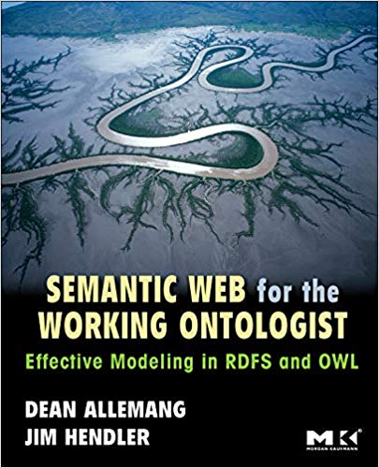



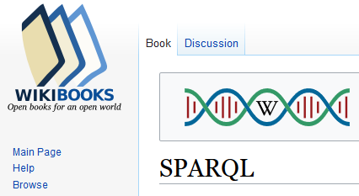
Recommended Reading: Semantic Web, X3D
Dean Allemang and Jim Hendler, Semantic Web for the Working Ontologist: Effective Modeling in RDFS and OWL, second edition, 2012.
Don Brutzman and Leonard Daly, X3D for Web Authors, Morgan, 2007.
Bob DuCharme, Learning SPARQL, second edition, 2013.
Leslie F. Sikos, Mastering Structured Data on the Semantic Web: from HTML5 Microdata to Linked Open Data, 2015.
Wikibooks SPARQL edition covers both language and also Web-based GUI: Wikidata Query Service SPARQL endpoint.

Slide 25
Contact
Don Brutzman, Ph.D.
brutzman@nps.edu
https://faculty.nps.edu/brutzman
Code USW/Br, Naval Postgraduate School
Monterey California 93943-5000 USA

Slide 26
Contact
Jakub Flotyński, Ph.D.
flotynski@kti.ue.poznan.pl
https://www.kti.ue.poznan.pl/en/jakub_flotynski.html
Department of Information Technology
Poznan University of Economics and Business
Poznan Poland

